Slide 1
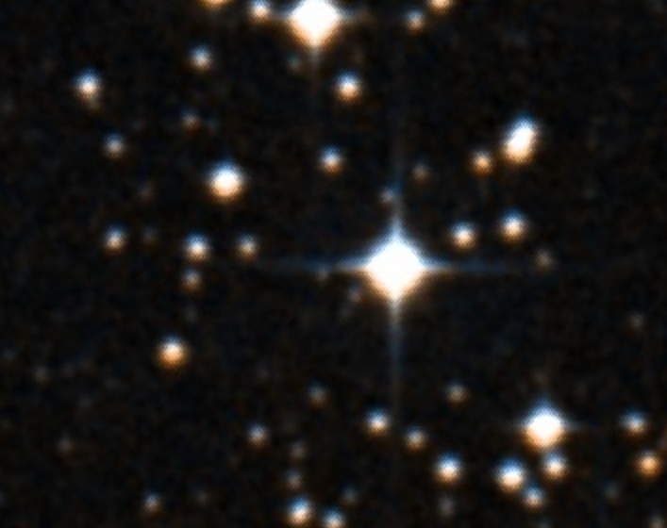



MCMC Hammering Out Photometric Models of Wolf-Rayet Wind-Eclipsing Binaries
WR 9
Anthony James Fabrega
Mentor: Dr. Noel Richardson
Embry-Riddle Aeronautical University
College of Arts and Sciences
Department of Physics and Astronomy
"Digitized Sky Survey Image of WR 9." Space Telescope Science Institute, 1987. NASA/IPAC Extragalactic Database.
Fabrega & Richardson (ERAU)

Slide 2
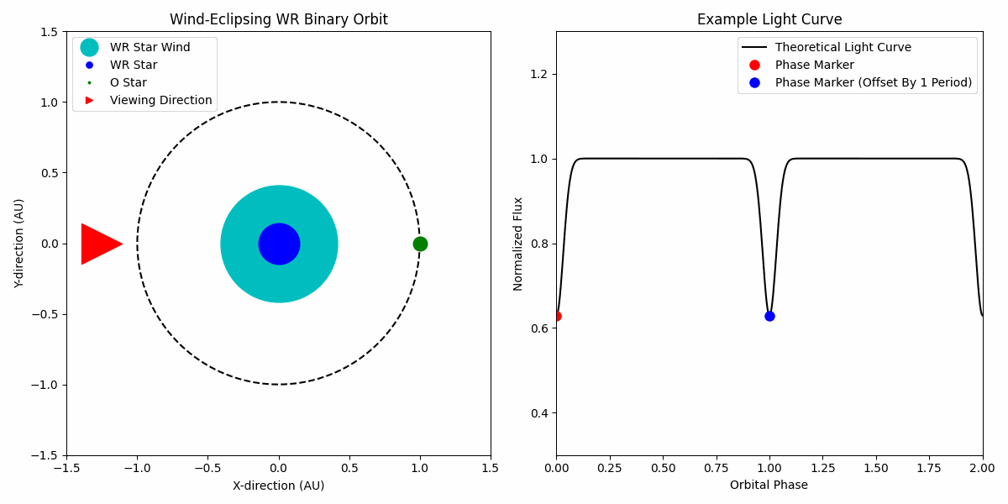
Fabrega & Richardson (ERAU)

Slide 3
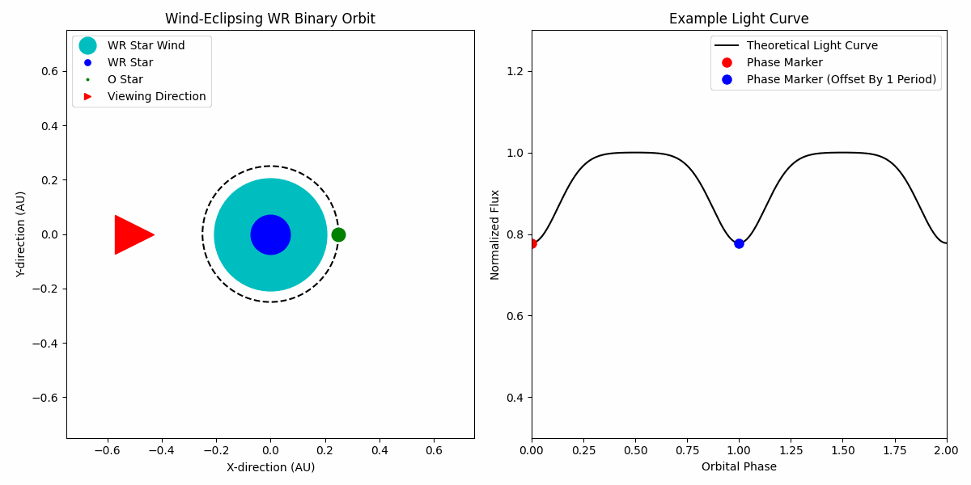
Fabrega & Richardson (ERAU)

Slide 4
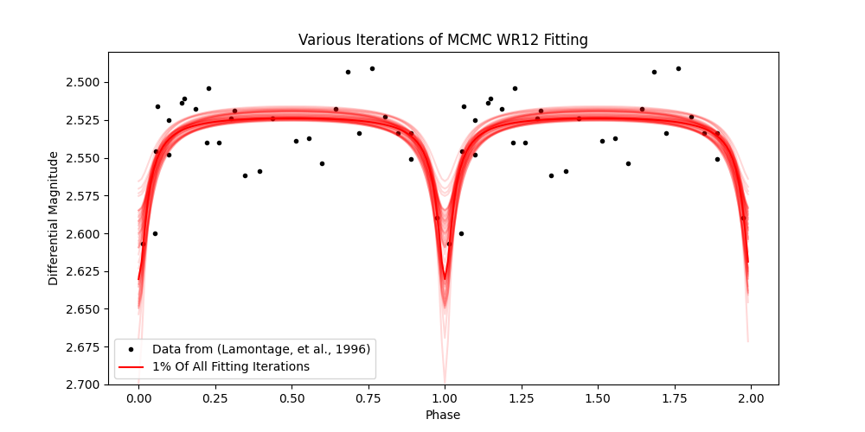
Monte Carlo: The Power of a Research Team in a Single Algorithm
Model Fit Parameters:
Orbital Inclination and Stellar Separations
Mass Loss Rate (i.e. number of electrons for scattering)
Constant Magnitude
  Or Flux*
Lamontagne, et al. 1996, AJ, 112, 2227.
Fabrega & Richardson (ERAU)
Foreman-Mackey, et al. 2013, PASP, 125, 306

Slide 5
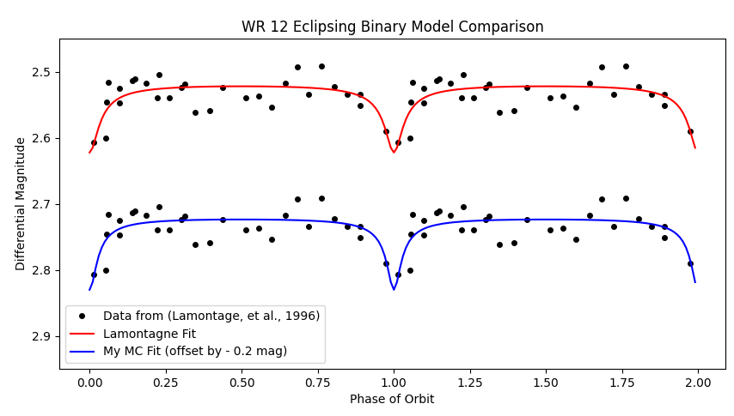
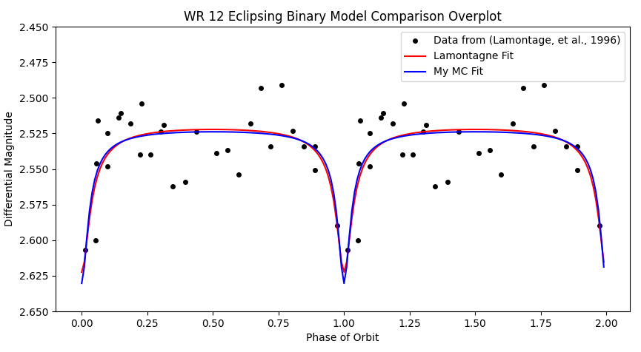
Model Matching
Lamontagne, et al. 1996, AJ, 112, 2227.
Summer 2024 spent model matching
Started out using Beta = 0 model (idealized)
  Assumes constant wind speed
Progressed onto Beta = 1 model
  Accounts for accelerating winds
Fabrega & Richardson (ERAU)

Slide 6
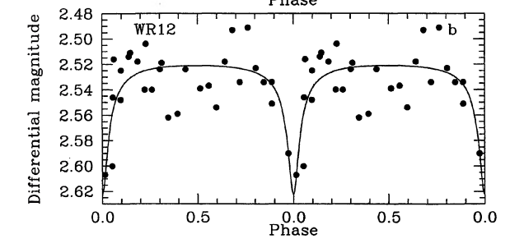
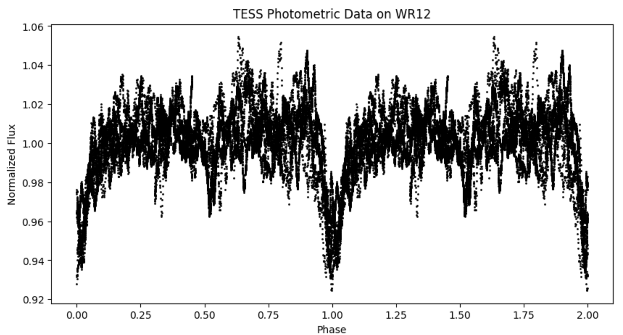
The Future is Now:
TESS and the Modernization of Wolf-Rayet Research
1000 times the data
Updating System Parameters
Phasing via Period04
Mag vs Flux
Pixel Contamination
  Stars within 2 arcmin
Lamontagne, et al. 1996, AJ, 112, 2227.
TESS
Fabrega & Richardson (ERAU)
Lenz, et al. 2005, CoAst, 146, 53

Slide 7
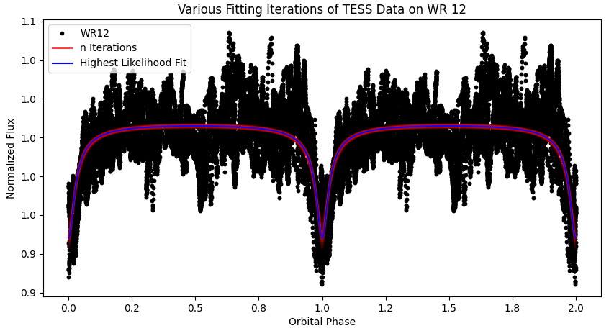
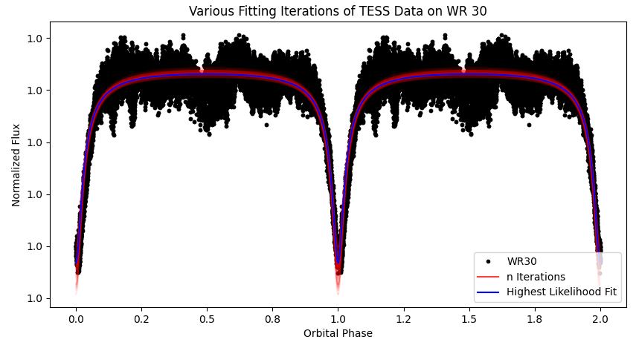
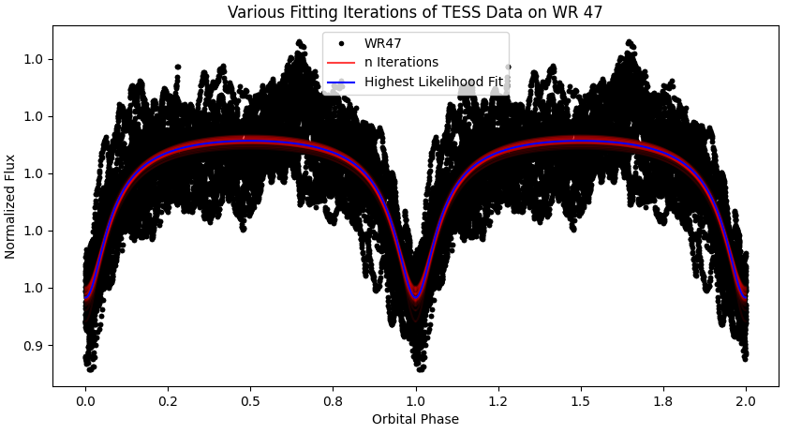
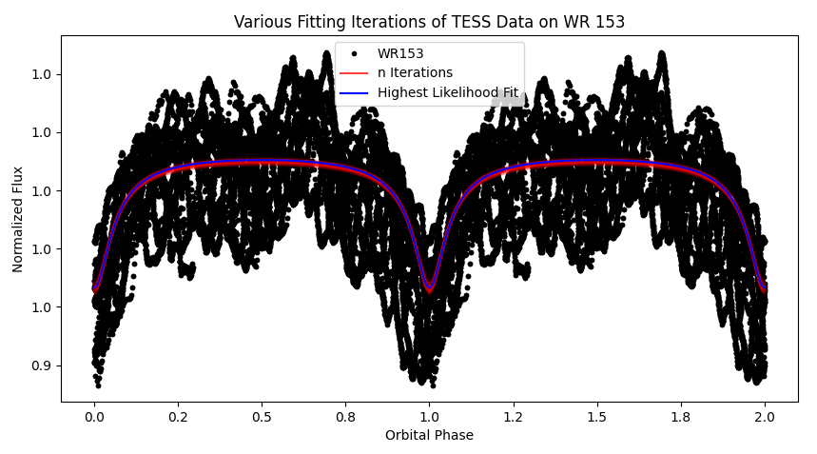
TESS
Fabrega & Richardson (ERAU)

Slide 8
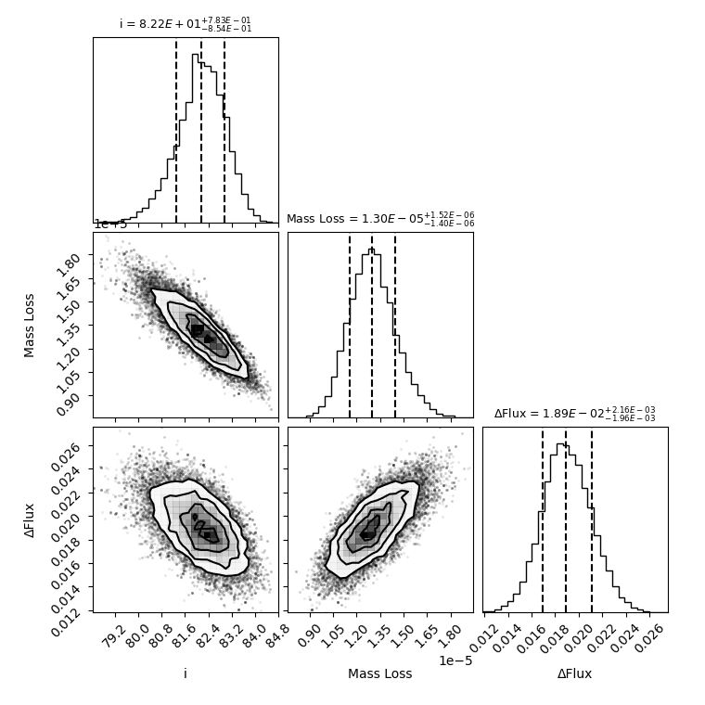
WR 30 Corner Plot
Cornering the Errors
Diagnosing Dependent Parameters:
  Mass loss rate's and orbital inclination's inverse relationship
  Finding parameter means and statistical errors (1st sigma)
  Regions of likelihood and the need for more iterations
Fabrega & Richardson (ERAU)
Foreman-Mackey, 2018, JOSS, 3, 715.

Slide 9
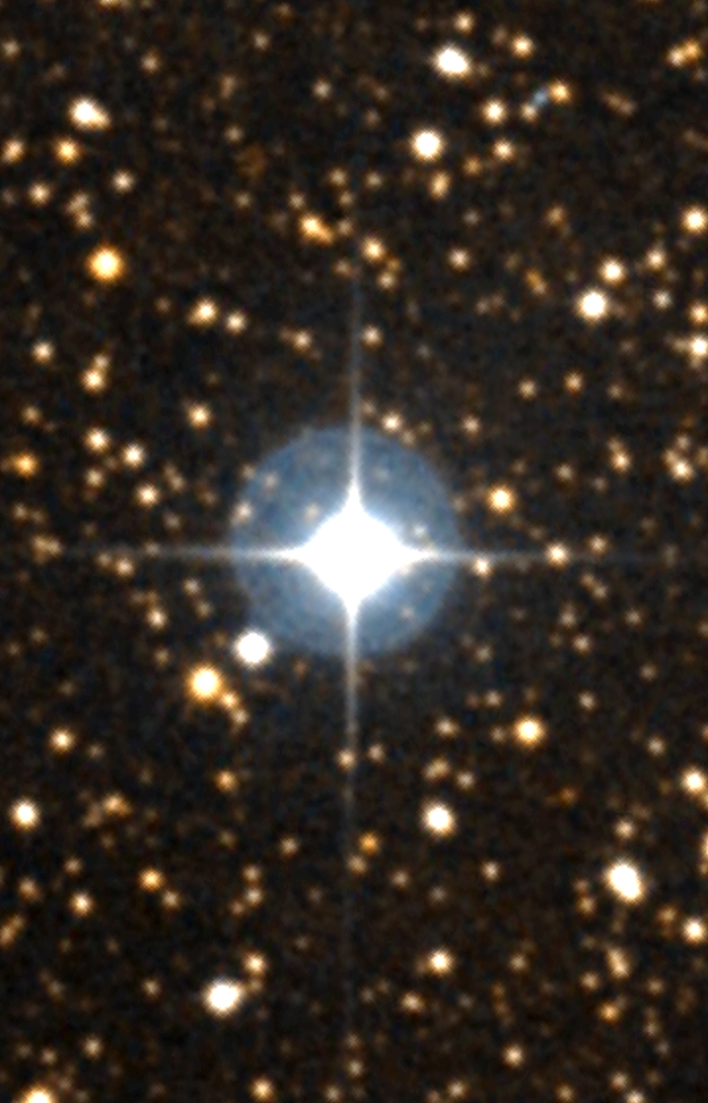
What's Next?
WR 139
Continue Contamination Correction
Iterations, Iterations, Iterations . . . .
Constantly Improving the Pipeline
Eventually Make Code Open Source
The Core-Eclipsers/Weirdos Amongst Us . . .?
Get Working on a Paper
Fabrega & Richardson (ERAU)
"Digitized Sky Survey Image of WR 139." Space Telescope Science Institute, 1987. NASA/IPAC Extragalactic Database.

